Slide 1
LAB 5
Abe Park 100592092
Rounald Riad Andrawes 100602857
Ernest LI 100658701

Slide 2
iPad Restaurant Application

Slide 3
We believe that we can improve on:
UI that is currently being used by most restaurants
Customer unfamiliarity with food
Customer satisfaction
Restaurant awareness of how customers feel about their dishes

Slide 4
Objectives:
Simplify ordering food by reducing uncertainty of the customers
Provide concise description of the food items and visuals to ensure the customer knows what they are purchasing
Increase sales and services by allowing dor easy customer feedback
Create an app that is compatible with all devices
Easy to navigate GUI
Recommend other options based on previous purchasing history
Provide an estimated time of arrival on deliveries, to ensure the customer that their purchase is on their way

Slide 5
Measures of Success
Financial growth
Increase in restaurant ratings
How widespread our app becomes
Customer satisfaction
Eventual expansion overseas

Slide 6
Risk Management
Personnel shortcoming: Train employees, hire higher quality members
Unusable user interface: Create a prototype and keep the user involved
Module coding taking longer than expected: Cost benefit analysis, is it worth spending more resources into the module, or can the project move on
External Server failure: Keep local server as backup
Client unsure of requirements: Use evolutionary development

Slide 7
Risk Management Cont.
Sickness affecting critical path activities: Allow employees to work from home, pay overtime to those who are able to continue, move employees from non-critical activities
Sickness affecting non-critical path activities: Allow employees to work from home, incremental delivery, ensure to make full use of float period

Slide 8
Infrastructure
Cloud servers: Used to store customer purchases, reviews, and restaurant information/menu items
Frontend application: Used by customers to connect to the backend and cloud servers
Backend application: Used to communicate with the frontend application which will allow the frontend to communicate with the server
GPS: Used to provide restaurant recommendations based on location
Internet connection: Allows the customer to connect with the server and make orders on the go

Slide 9
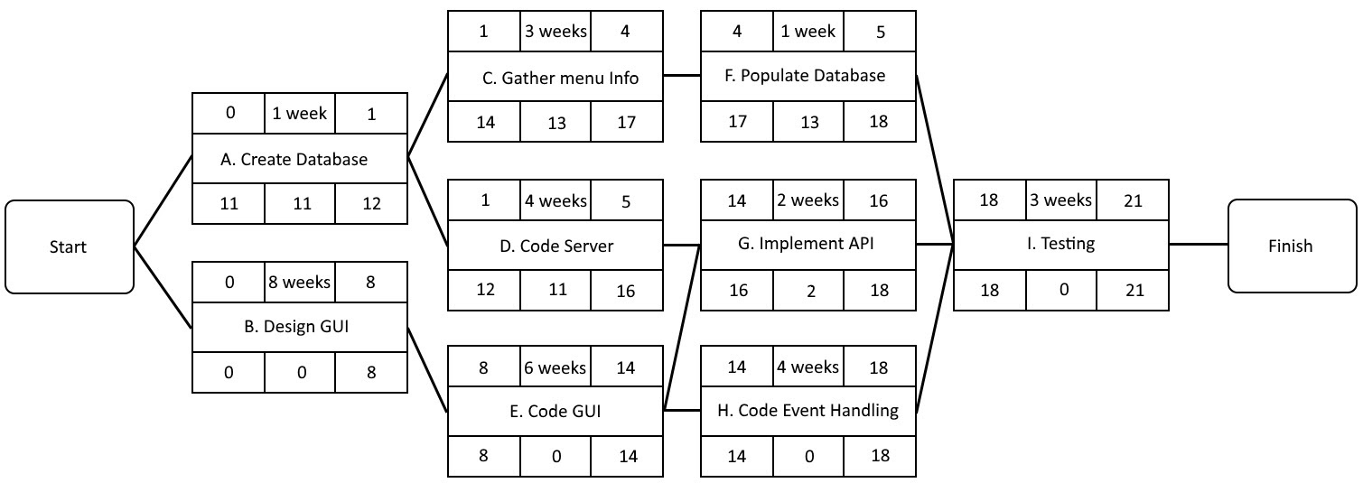

Slide 10
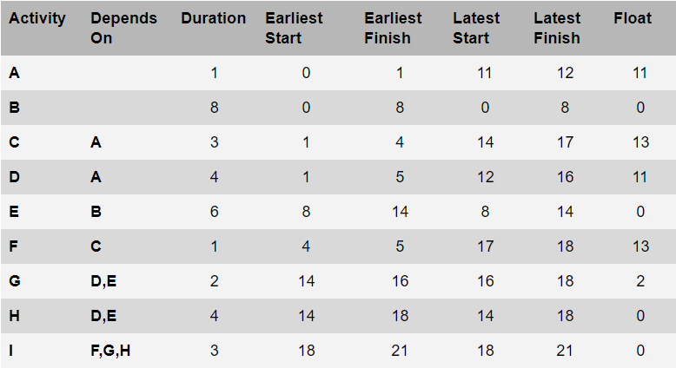

Slide 11
Resource Name | Work
Software Designer | 448 hrs
Design GUI | 448 hrs
Software Coder A | 336 hrs
Code Server | 224 hrs
Implement API | 112 hrs
Software Coder B | 560 hrs
Code GUI | 336 hrs
Resource Name | Work
Code Event Handling | 224 hrs
Tester | 168 hrs
Testing | 168 hrs
Database Analyst | 280 hrs
Create Database | 56 hrs
Gather menu info | 168 hrs
Populate Database | 56 hrs

Slide 12
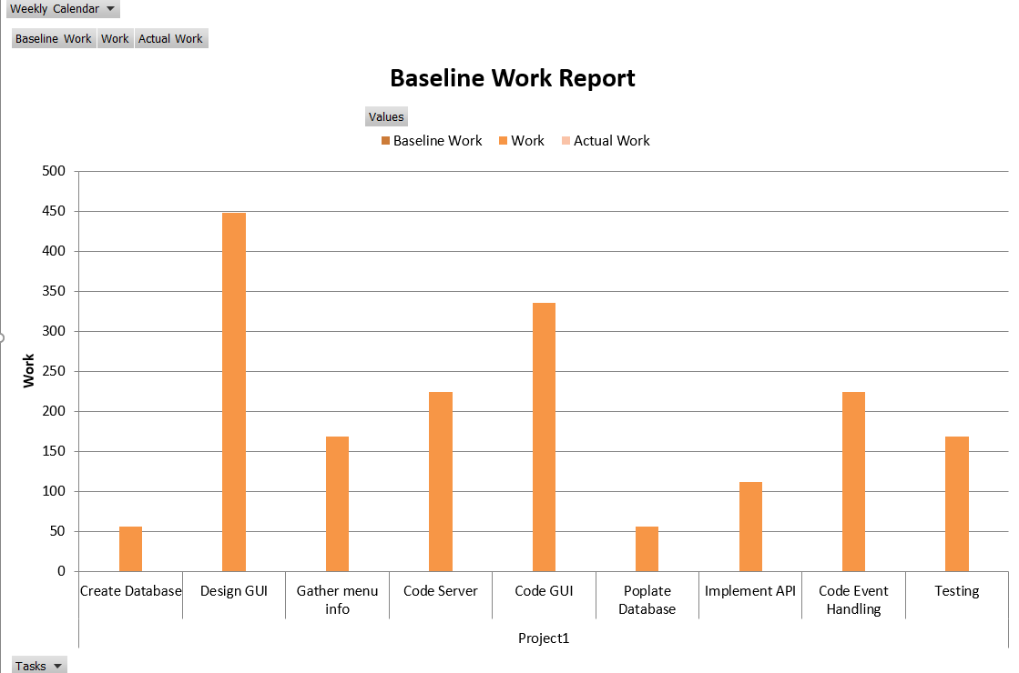

Slide 13
